Slide 1
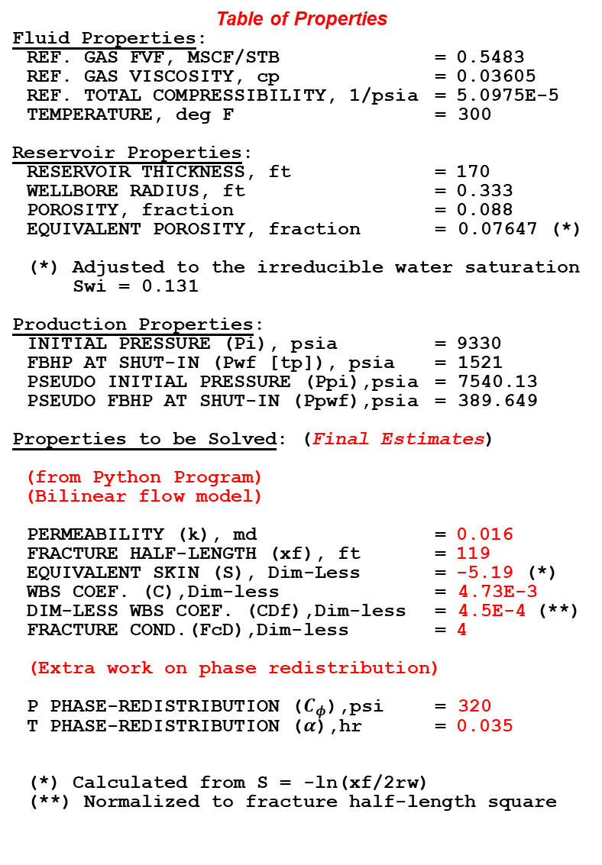
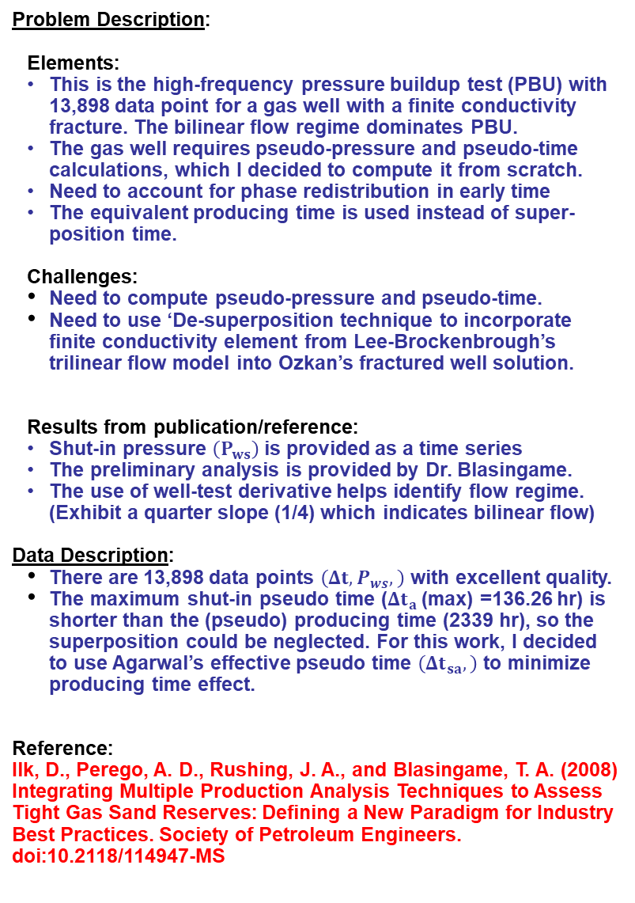
Problem Description/Data/Reference: Final Project (PTA) - SPE 114947 (Ilk)
Problem Description:
Elements:
This is the high-frequency pressure buildup test (PBU) with 13,898 data point for a gas well with a finite conductivity fracture. The bilinear flow regime dominates PBU.
The gas well requires pseudo-pressure and pseudo-time calculations, which I decided to compute it from scratch.
Need to account for phase redistribution in early time
The equivalent producing time is used instead of super-position time.
Challenges:
Need to compute pseudo-pressure and pseudo-time.
Need to use ‘De-superposition technique to incorporate finite conductivity element from Lee-Brockenbrough’s trilinear flow model into Ozkan’s fractured well solution.
Results from publication/reference:
Shut-in pressure $\left(P_{ws}\right)$ is provided as a time series
The preliminary analysis is provided by Dr. Blasingame.
The use of well-test derivative helps identify flow regime. (Exhibit a quarter slope (1/4) which indicates bilinear flow)
Data Description:
There are 13,898 data points $\left(Δt, P_{ws},\right)$ with excellent quality.
The maximum shut-in pseudo time ($Δt_{a}$(max) =136.26 hr) is shorter than the (pseudo) producing time (2339 hr), so the superposition could be neglected. For this work, I decided to use Agarwal’s effective pseudo time $\left(Δt_{sa},\right)$ to minimize producing time effect.
Reference:
Ilk, D., Perego, A. D., Rushing, J. A., and Blasingame, T. A. (2008) Integrating Multiple Production Analysis Techniques to Assess Tight Gas Sand Reserves: Defining a New Paradigm for Industry Best Practices. Society of Petroleum Engineers. doi:10.2118/114947-MS
Table of Properties
Fluid Properties:
REF. GAS FVF, MSCF/STB = 0.5483
REF. GAS VISCOSITY, cp = 0.03605
REF. TOTAL COMPRESSIBILITY, 1/psia = 5.0975E-5
TEMPERATURE, deg F = 300
Reservoir Properties:
RESERVOIR THICKNESS, ft = 170
WELLBORE RADIUS, ft = 0.333
POROSITY, fraction = 0.088
EQUIVALENT POROSITY, fraction = 0.07647 (*)
(*) Adjusted to the irreducible water saturation
Swi = 0.131
Production Properties:
INITIAL PRESSURE (Pi), psia = 9330
FBHP AT SHUT-IN (Pwf [tp]), psia = 1521
PSEUDO INITIAL PRESSURE (Ppi),psia = 7540.13
PSEUDO FBHP AT SHUT-IN (Ppwf),psia = 389.649
Properties to be Solved: (Final Estimates)
(from Python Program)
(Bilinear flow model)
PERMEABILITY (k), md = 0.016
FRACTURE HALF-LENGTH (xf), ft = 119
EQUIVALENT SKIN (S), Dim-Less = -5.19 (*)
WBS COEF. (C),Dim-less = 4.73E-3
DIM-LESS WBS COEF. (CDf),Dim-less = 4.5E-4 (**)
FRACTURE COND.(FcD),Dim-less = 4
(Extra work on phase redistribution)
P PHASE-REDISTRIBUTION ($C_{φ}$),psi = 320
T PHASE-REDISTRIBUTION ($α$),hr = 0.035
(*) Calculated from S = -ln(xf/2rw)
(**) Normalized to fracture half-length square

Slide 2
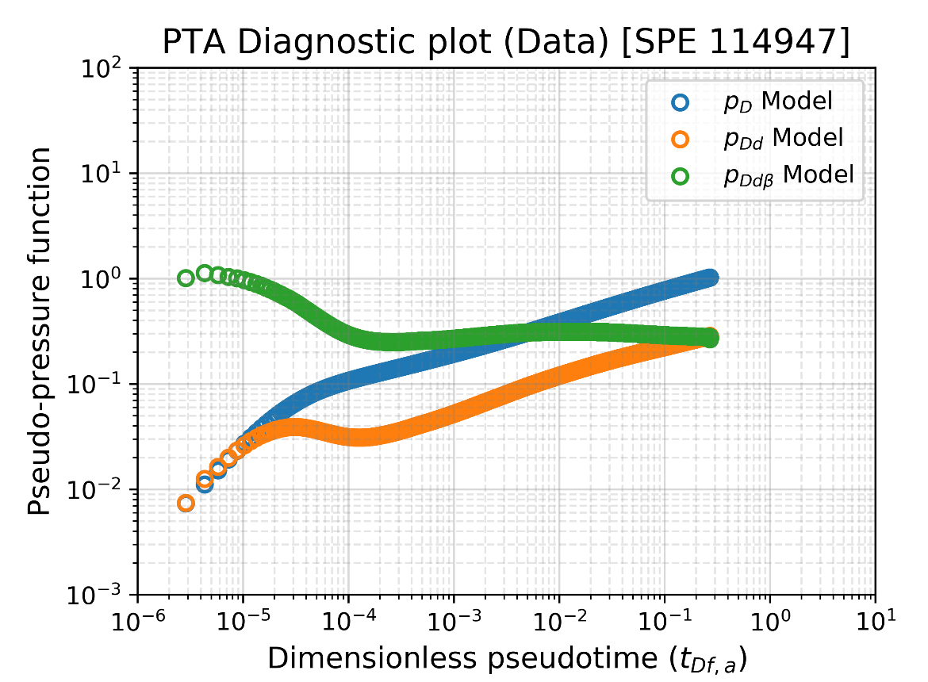
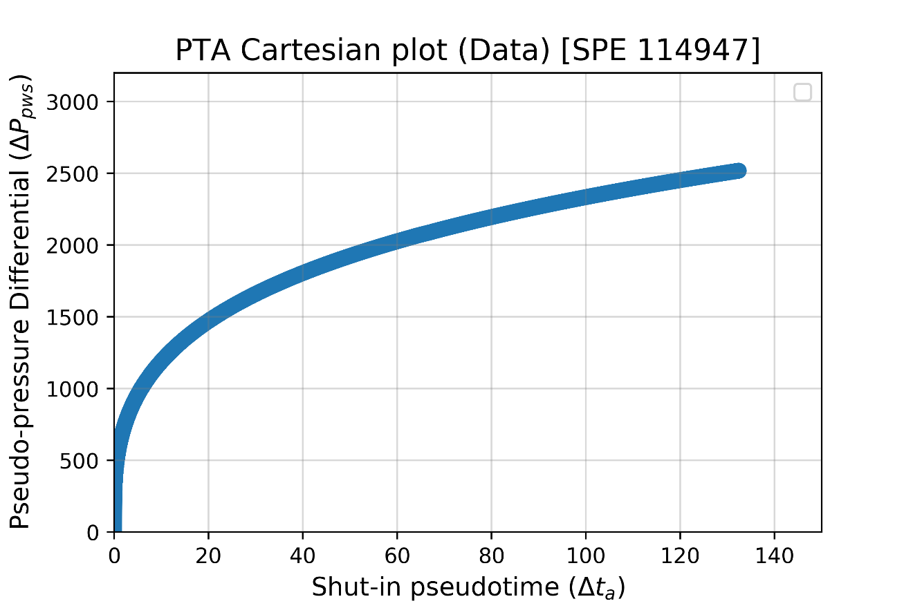
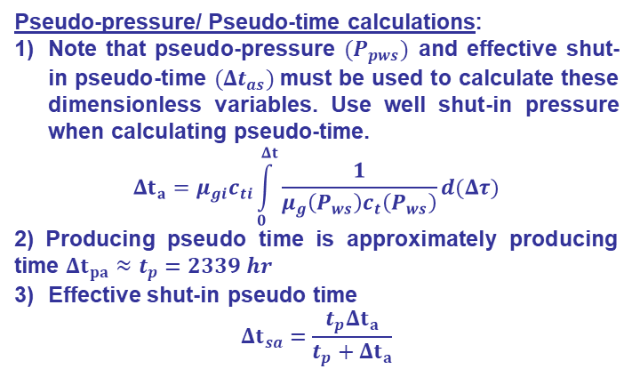
Diagnostics / Hand analysis plots
Diagnostic Plot [log-log]:
Cartesian Plot:
Bilinear flow regime
Well test derivative slope = 1/4
13,898 Data (Excellent quality)
1
4
1
WBS
Slope = 1
1
Comment:
This is not a perfect 1/4 slope line, but it is close enough.
This is obviously not linear flow (slope = 1/2). Bilinear flow is more pronounced in PTA Data
The wellbore storage is changing in the beginning, as there is some hump in well test derivative during the early time due to phase redistribution. Fair’s exponential phase redistribution is used.
Use a power law trick integral for the first panel when calculating gas property integration.
Pseudo-pressure/ Pseudo-time calculations:
Note that pseudo-pressure $(P_{pws})$ and effective shut-in pseudo-time $({Δt}_{as})$must be used to calculate these dimensionless variables. Use well shut-in pressure when calculating pseudo-time.
$$Δt_{a}=μ_{gi}c_{ti}\int_{0}^{Δt}{\frac{1}{μ_{g}\left(P_{ws}\right)c_{t}\left(P_{ws}\right)}d(Δτ)}$$
2) Producing pseudo time is approximately producing time $Δt_{pa}≈t_{p}=2339 hr$
Effective shut-in pseudo time
$$Δt_{sa}=\frac{t_{p}Δt_{a}}{t_{p}+Δt_{a}}$$

Slide 3
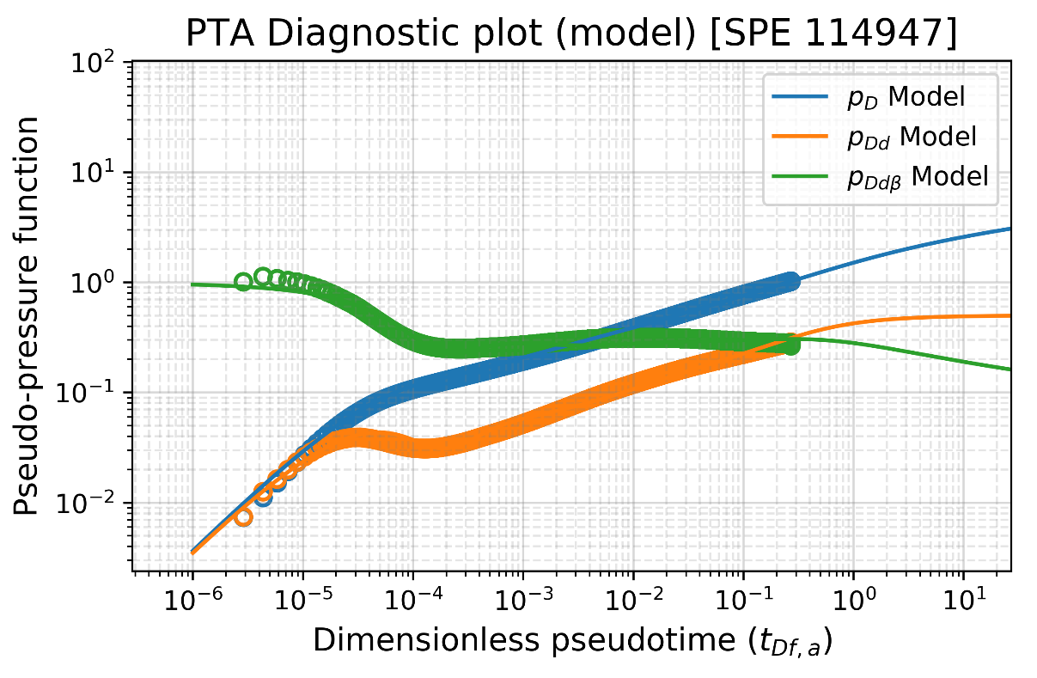
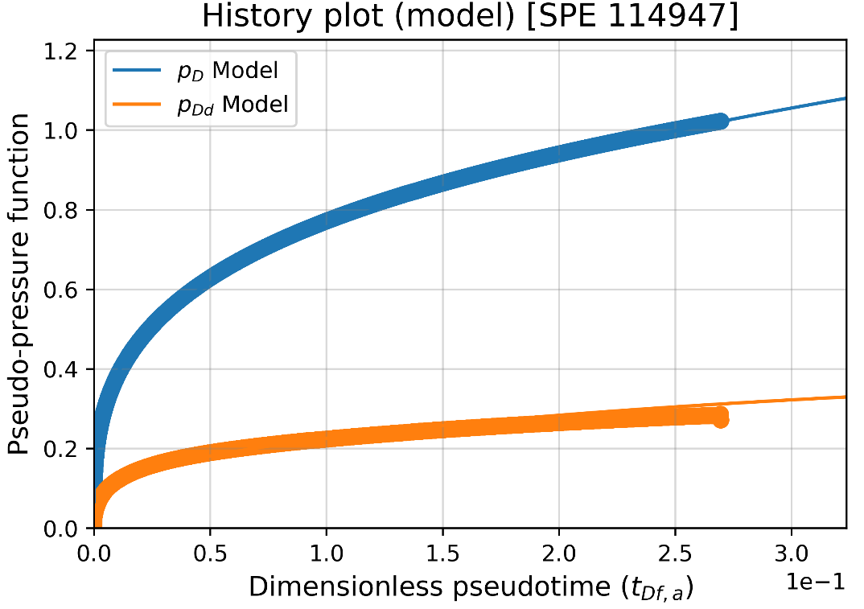
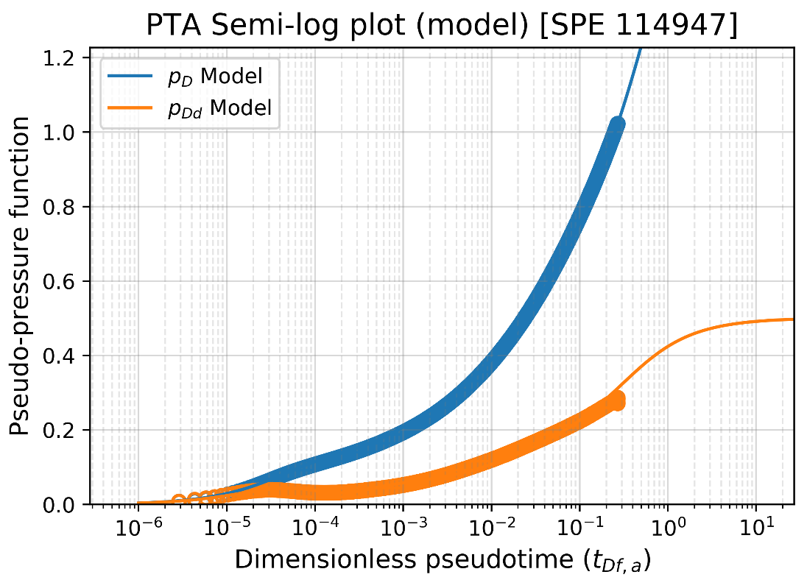
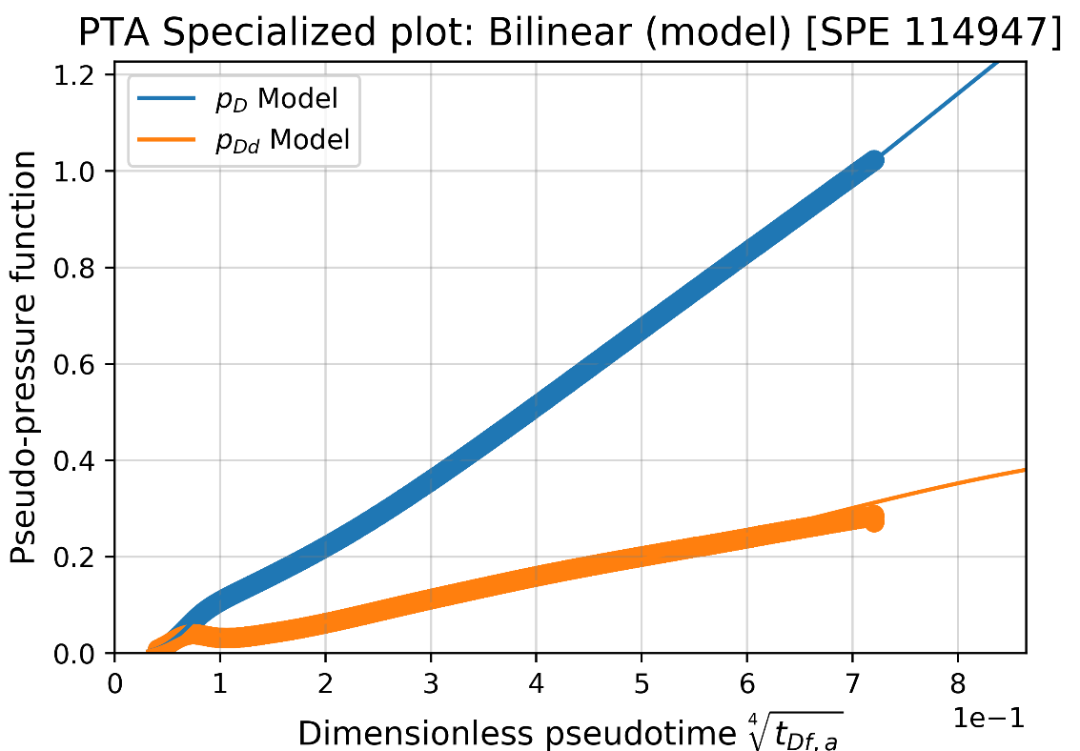
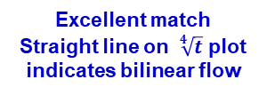
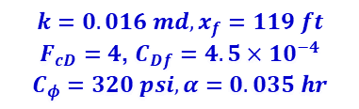
Analysis Summary Plots (Model)
“Model” matching: (by Python)
$$k=0.016 md, x_{f}=119 ft$$
$F_{cD}=4$, $C_{Df}=4.5×10^{−4}$
$$C_{φ}=320 psi, α=0.035 hr$$
Excellent match throughout history!
WBS
IARF
Bilinear
Phase redistribution
Excellent match
Straight line on $\sqrt[4]{t}$ plot indicates bilinear flow
Excellent match throughout history!

Slide 4
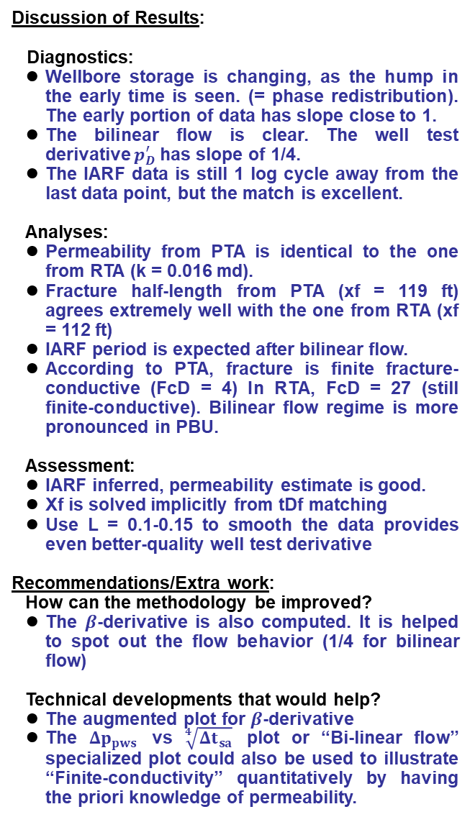
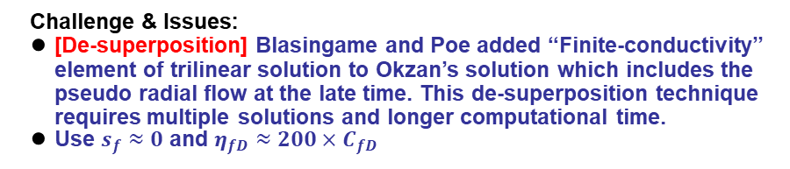
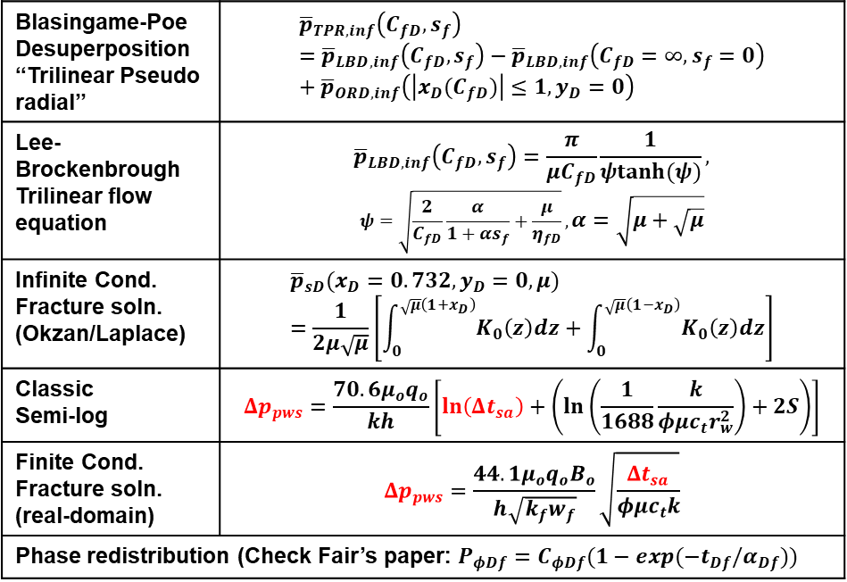
Method of Work / Discussion of Results
Method of Work:
Starting Point:
The buildup test requires the adjustment of the time and pressure plotting functions. In diagnostic plot, Agarwal effective shut-in pseudo time is used.
Type curve matching requires Stehfest’s algorithm.
Governing Equations:
Discussion of Results:
Diagnostics:
Wellbore storage is changing, as the hump in the early time is seen. (= phase redistribution). The early portion of data has slope close to 1.
The bilinear flow is clear. The well test derivative $p_{D}^{′}$has slope of 1/4.
The IARF data is still 1 log cycle away from the last data point, but the match is excellent.
Analyses:
Permeability from PTA is identical to the one from RTA (k = 0.016 md).
Fracture half-length from PTA (xf = 119 ft) agrees extremely well with the one from RTA (xf = 112 ft)
IARF period is expected after bilinear flow.
According to PTA, fracture is finite fracture-conductive (FcD = 4) In RTA, FcD = 27 (still finite-conductive). Bilinear flow regime is more pronounced in PBU.
Assessment:
IARF inferred, permeability estimate is good.
Xf is solved implicitly from tDf matching
Use L = 0.1-0.15 to smooth the data provides even better-quality well test derivative
Recommendations/Extra work:
How can the methodology be improved?
The $β$-derivative is also computed. It is helped to spot out the flow behavior (1/4 for bilinear flow)
Technical developments that would help?
The augmented plot for $β$-derivative
The $Δp_{pws}$ vs $\sqrt[4]{Δt_{sa}}$ plot or “Bi-linear flow” specialized plot could also be used to illustrate “Finite-conductivity” quantitatively by having the priori knowledge of permeability.
Blasingame-Poe Desuperposition “Trilinear Pseudo radial” | $${\overline{p}}_{TPR,inf}\left(C_{fD},s_{f}\right)={\overline{p}}_{LBD,inf}\left(C_{fD},s_{f}\right)−{\overline{p}}_{LBD,inf}\left(C_{fD}=∞,s_{f}=0\right)+{\overline{p}}_{ORD,inf}\left(\left|x_{D}(C_{fD})\right|≤1,y_{D}=0\right)$$
Lee-Brockenbrough Trilinear flow equation | $${\overline{p}}_{LBD,inf}\left(C_{fD},s_{f}\right)=\frac{π}{μC_{fD}}\frac{1}{ψtanh(ψ)},$$ $$ψ=\sqrt{\frac{2}{C_{fD}}\frac{α}{1+αs_{f}}+\frac{μ}{η_{fD}}},α=\sqrt{μ+\sqrt{μ}}$$
Infinite Cond. Fracture soln. (Okzan/Laplace) | $${\overline{p}}_{sD}(x_{D}=0.732,y_{D}=0,μ)=\frac{1}{2μ\sqrt{μ}}\left[\int_{0}^{\sqrt{μ}\left(1+x_{D}\right)}{K_{0}\left(z\right)dz}+\int_{0}^{\sqrt{μ}\left(1−x_{D}\right)}{K_{0}\left(z\right)dz}\right]$$
Classic Semi-log | $$Δp_{pws}=\frac{70.6μ_{o}q_{o}}{kh}\left[\ln\left(Δt_{sa}\right)+\left(\ln\left(\frac{1}{1688}\frac{k}{φμc_{t}r_{w}^{2}}\right)+2S\right)\right]$$
Finite Cond. Fracture soln. (real-domain) | $$Δp_{pws}=\frac{44.1μ_{o}q_{o}B_{o}}{h\sqrt{k_{f}w_{f}}}\sqrt{\frac{Δt_{sa}}{φμc_{t}k}}$$
Phase redistribution (Check Fair’s paper: $P_{φDf}=C_{φDf}(1−exp(−t_{Df}/α_{Df}))$
Challenge & Issues:
[De-superposition] Blasingame and Poe added “Finite-conductivity” element of trilinear solution to Okzan’s solution which includes the pseudo radial flow at the late time. This de-superposition technique requires multiple solutions and longer computational time.
Use $s_{f}≈0$ and $η_{fD}≈200×C_{fD}$

